Slide 1

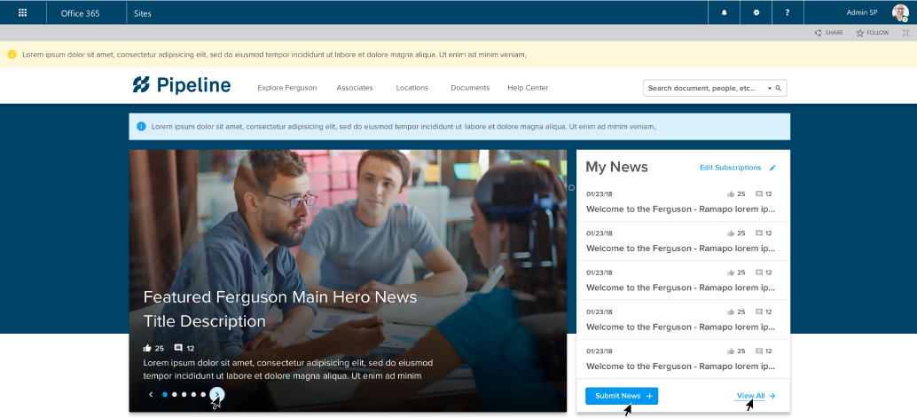
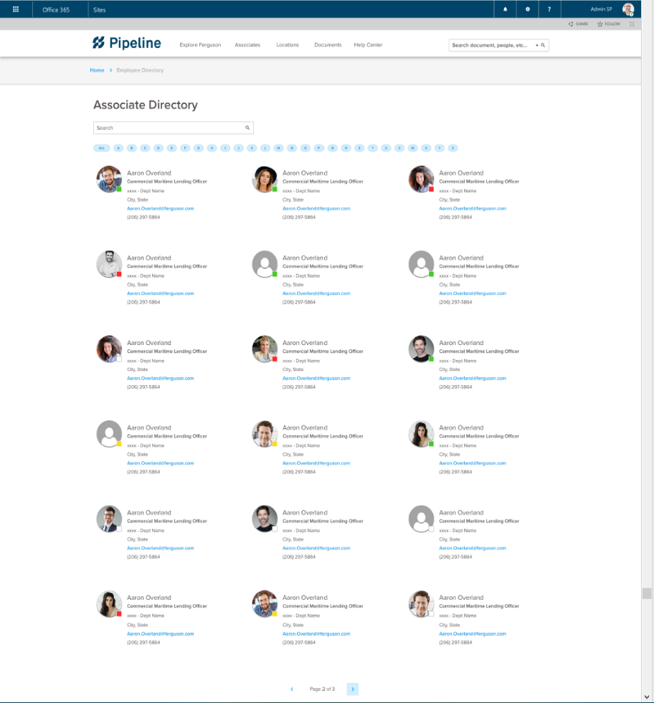
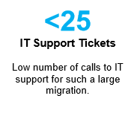
FERGUSON ENTERPRISES
SharePoint Online Migration
The Challenge
Ferguson is the largest wholesaler of plumbing supplies, HVAC products, and building supplies to professional contractors and homeowners in North America.
Affirma was tasked to move their SharePoint 2010 and 2013 intranet to SharePoint Online. The team worked with stakeholders in Virginia as well as with their co-ops in Canada and the UK to configure Development and Production tenants.
What We Did
Affirma designed and built “Pipeline,” migrated content from the old intranet, and provided onsite workshops and training. The team also provided guidance on how to best leverage Microsoft Teams and improve their use of Delve and Active Directory (which pulled from their HRIS).
Ferguson now has a responsive intranet with lots of new opportunities for employee-contributed content.

